Slide 1
Analysis of Google Play App reviews
Team Members
Sanket Prabhu
Chirag Chudasama
Kunal Kapoor

Slide 2
Introduction
most app stores provide only an average rating (out of 5) for each app.
It is difficult to identify why people like or dislike a particular.
We aim to solve this problem.

Slide 3
Methodology
Creating a repository of reviews
Creating a corpus of subjective words
Identify topics of interest
Identifying topics in a review
Ranking topics in order of relevance
Identifying representative reviews for a topic

Slide 4
Creating Repository of reviews
Downloading reviews
Audible
Flixster
Jewels
Operamini
Pandora
Soundhound
Yelp

Slide 5
Creating Repository of reviews
Processing reviews
A unique author ID,
Review Creation Time
Rating (ranging from 1 to 5)
Review Text

Slide 6
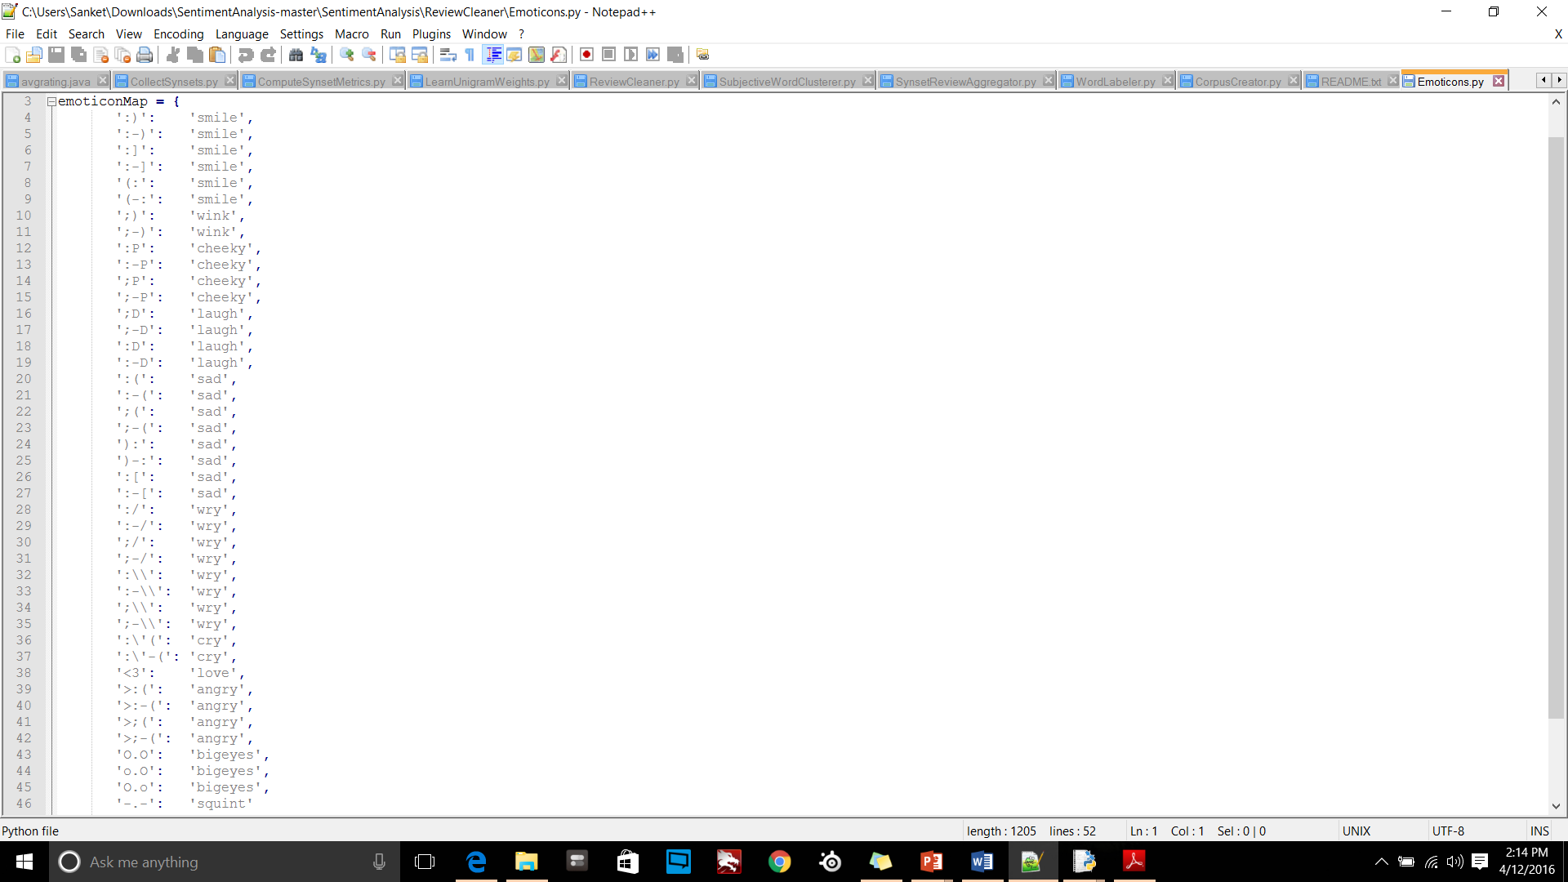
Creating Repository of reviews
Emoticons and exclamation marks are transformed to symbols.

Slide 7
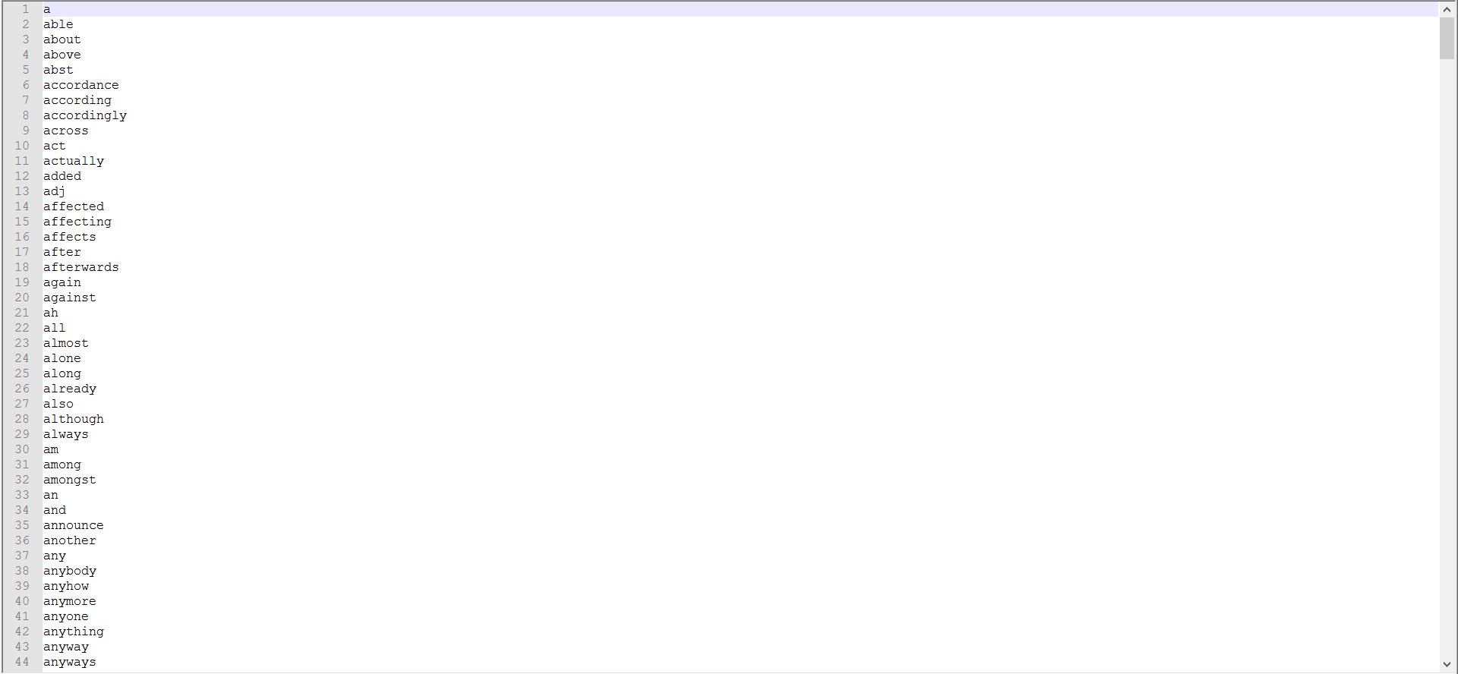
List of Stop Words

Slide 8
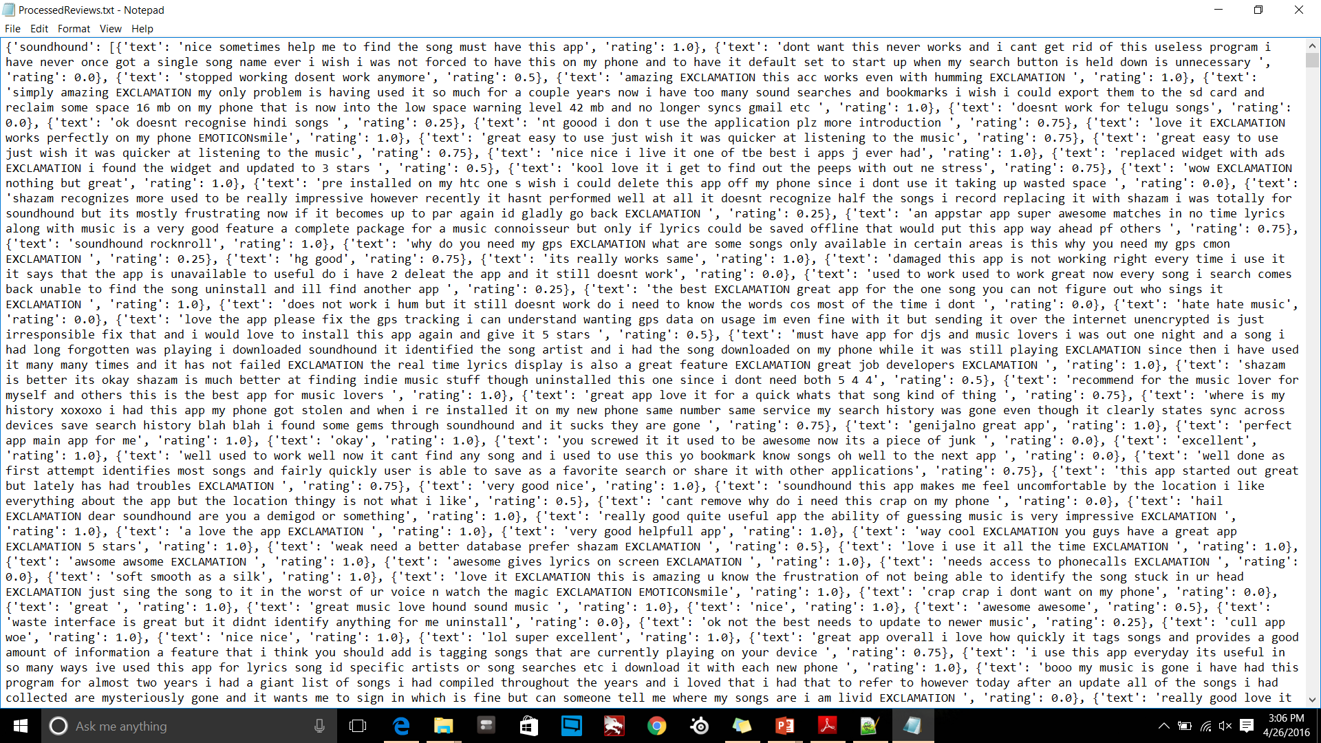
Output: ProcessedReviews.txt

Slide 9
Creating Corpus of Subjective words
Subjective Word Like Crash, Stable
A review with the word “crash” in it is likely to have a low rating, whereas one with “stable” in it is likely to have a high rating.
We are planning to extract subjective words from reviews by analyzing their power to predict the rating of a review. We are planning to apply logistic regression to review ratings.

Slide 10
Logistic Regression
Learning Weights (Subjective words)
weights = collections.defaultdict(float)
learningRate = 0.0001, epsilon = 0.001
𝛼𝛼=0.0001, 𝜖𝜖=0.001,
Finally, our training set was 90% of all reviews in the repository, and the test set was the remaining 10%.
newWeights[f] = newWeights[f] + learningRate * (rating - hypothesis(features, weights)) * features[f]

Slide 11
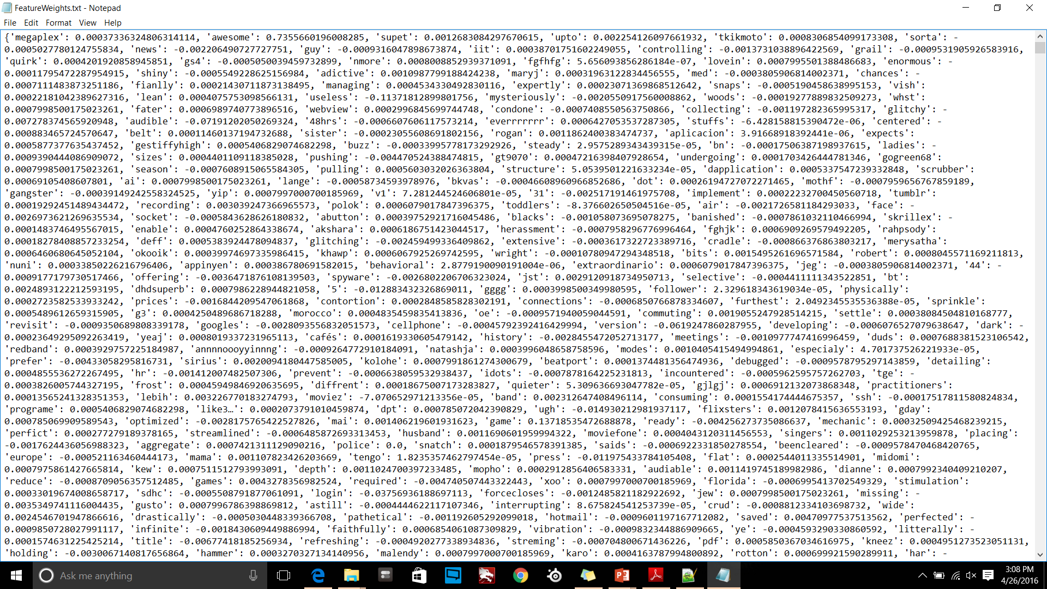
Output: FeatureWeights.txt

Slide 12
Identifying topics of interest
We have a list of subjective words that indicate a positive or negative opinion. In this segment, we will map these words to topics of interest.
We are planning to use WordNet(Lexical database for English Lang)
WordNet allows us to group words into “synsets”. Each synset is a group of synonymous words.
We hypothesize words that are synonyms represent the same topic

Slide 13
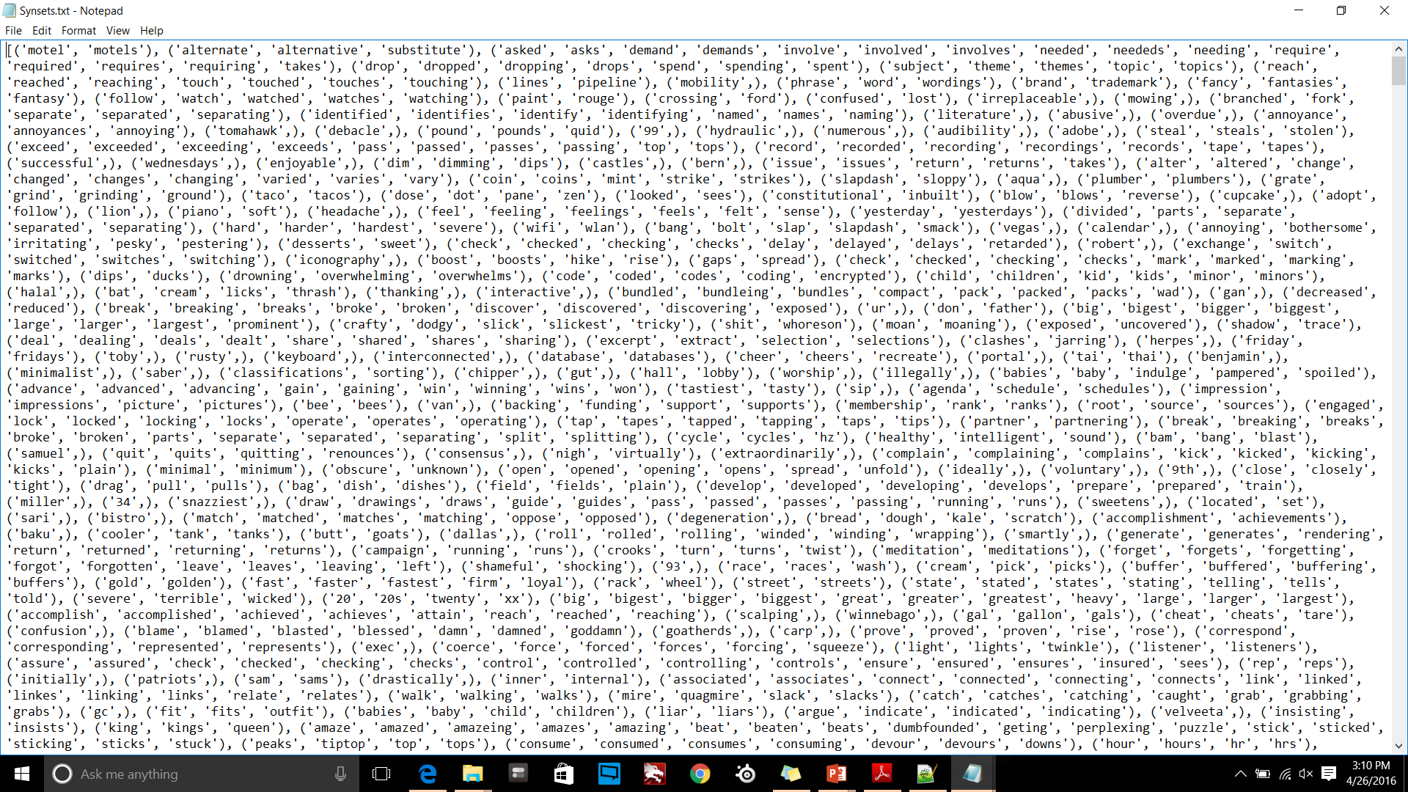
Output: Synsets.txt

Slide 14
Final Output
We started out with the goal of providing a more detailed analyses of the reviews of an app to a developer, beyond an average rating.
We will be able to provide a list of topics that are relevant to the manner in which the developer wishes to interpret the reviews, an average rating that conveys general sentiment for that topic, and representative reviews that give insightful criticism regarding the topic.

Slide 15
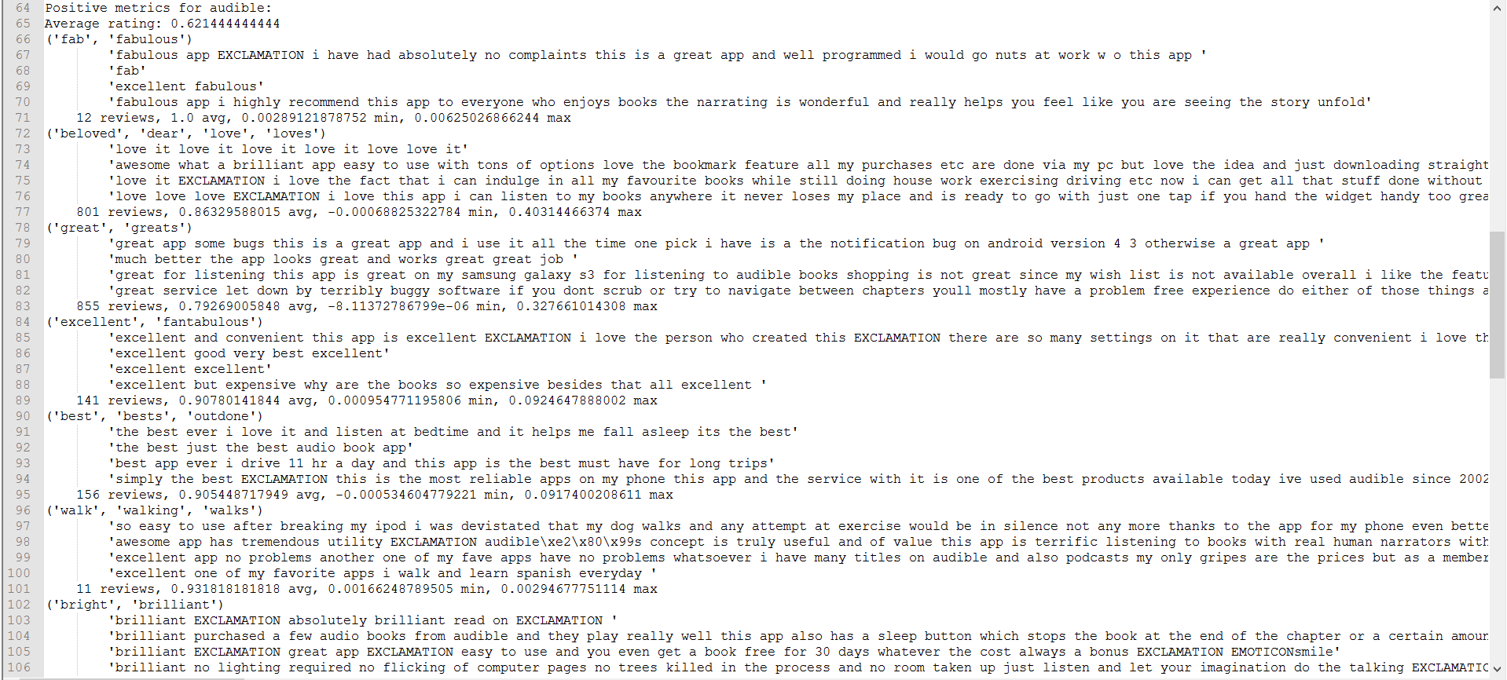
Final Output: Positive Reviews

Slide 16
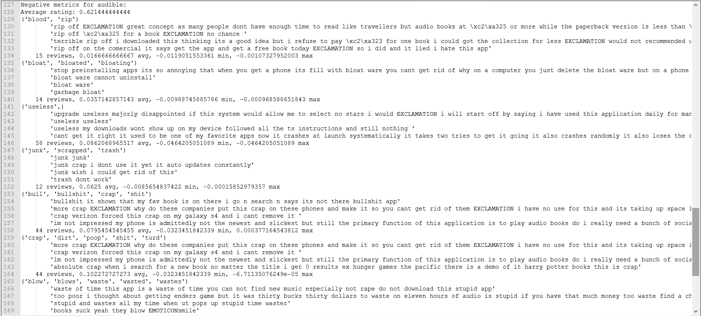
Final Output: Negative Reviews

Slide 17


